Slide 1


WEB APPLICATION PEN-TESTING (WAPT)
Diploma in CSF
Academic Year (AY) 22/23 – October `22
Week 1.2
Hacker’s view of the web - II
Last Updated: 17/10/2022

Slide 2
Contents
HTTP Methods
Web Application Architecture

Slide 3
Web Application Architecture

Slide 4
Web Application Architecture
For the purpose of studying this module, a web application architecture can be referred to as a complete setup platform/virtual environment that can be used to deliver services of a web application.
In an actual production environment, the basic components thus consists of the following:
Hardware Server/VM with Server Operating System
Web Server
Database Server
Application Server
Browser Client
Pen-tester needs to know each of these components and their make in order to carry out the test effectively and productively.

Slide 5
Server Operating System
This is the Operating System (OS) used in the server hardware/VM that host the Web Application.
Example of Server OS
Windows Server 2019, Ubuntu Server 21.04, Fedora 34 Server …
Server OS needs to be hardened to prevent attacks that make use of the known vulnerabilities.
Check it out at http://cvedetails.com for known vulnerabilities
If the attackers can exploit the Server OS directly, then the complete web application and its resources are compromised.
Hacking into OS will be taught in the Ethical Hacking Module next semester. Hacking into OS via web application will be covered in this module.

Slide 6
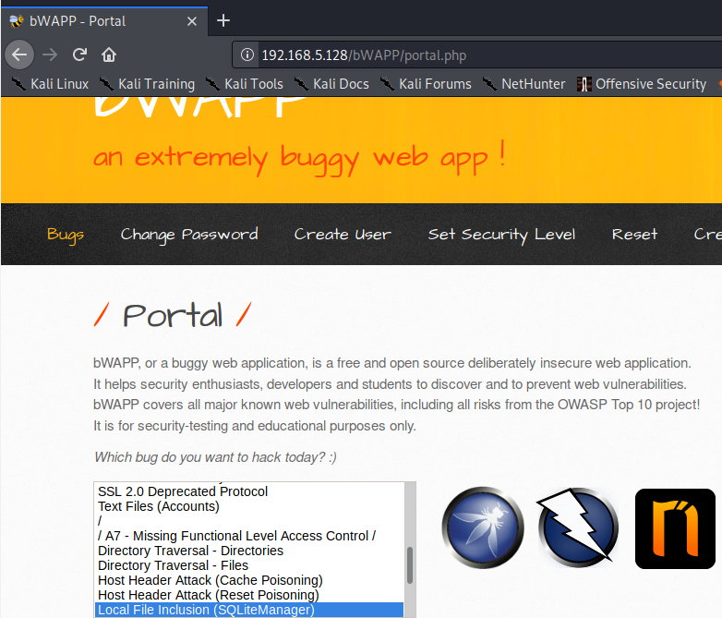
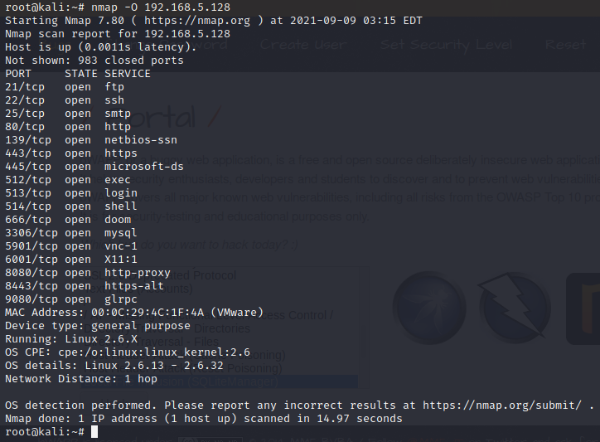
Mapping of Server OS Using Nmap
Mapping – also know as Fingerprinting

Slide 7
Web Server
Web Server is a daemon process that is always listen at port 80 (or any other designated port., viz 8000, 8080 etc) for service request.
Example of commonly use web server are:
IIS (Internet Information Server), Apache Web Server etc.
These software servers also possess different vulnerabilities that attackers could make use of to exploit and gain access into the Server OS.
Check it out at http://cvedetails.com
Pen-tester needs to first map out the type of Web Server is being used to host the web application.
Use ”whatweb” command in Kali-Linux

Slide 8
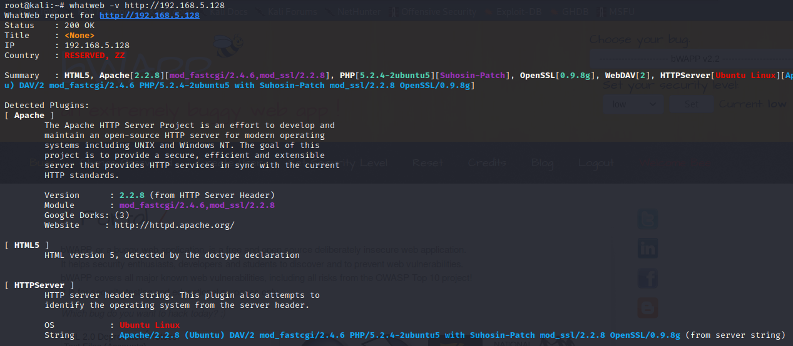
Mapping of Web Server Using WhatWeb

Slide 9
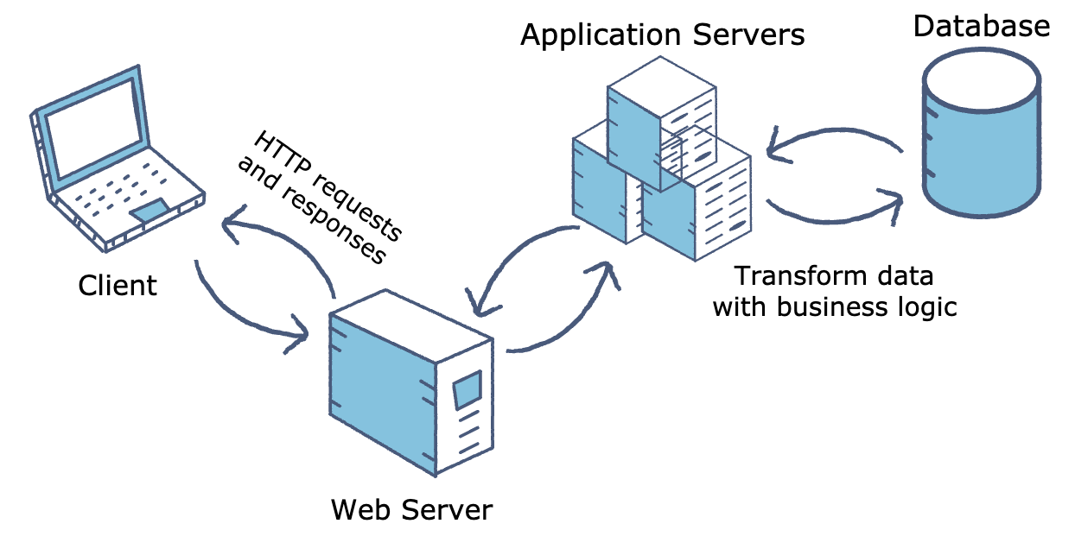
Application Server
A website that provides both static and dynamically generated content runs web servers for the static content and application servers to generate content dynamically.
An application server is a software process that resides on the server-side and provides business logic behind any application.
Can be housed in one hardware server.

Slide 10
Application Servers
Some well-known Application Servers
Tomcat for Java
IIS for .NET
Gunicorn for Python
Unicorn for Ruby.
JBoss: Open-source server from JBoss community.
Glassfish: Provided by Sun Microsystem. Now acquired by Oracle.
Weblogic: Provided by Oracle. It more secured.
Websphere: Provided by IBM.
There are many more in the market , each as its strength and weaknesses.
https://en.wikipedia.org/wiki/Application_server
Application servers needs to be patched to prevent attacks that make use of the known vulnerabilities.
Check it out at http://cvedetails.com for known vulnerabilities

Slide 11
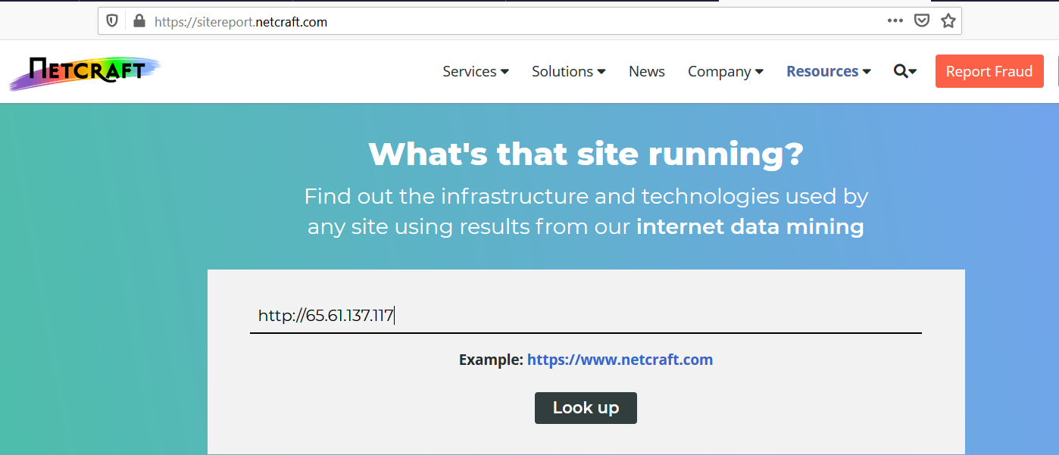
Mapping of Application Server Using Netcraft
One of the tool we could make use to check what application server is being deployed of is called “netcraft”, which is web based tool.
https://sitereport.netcraft.com

Slide 12
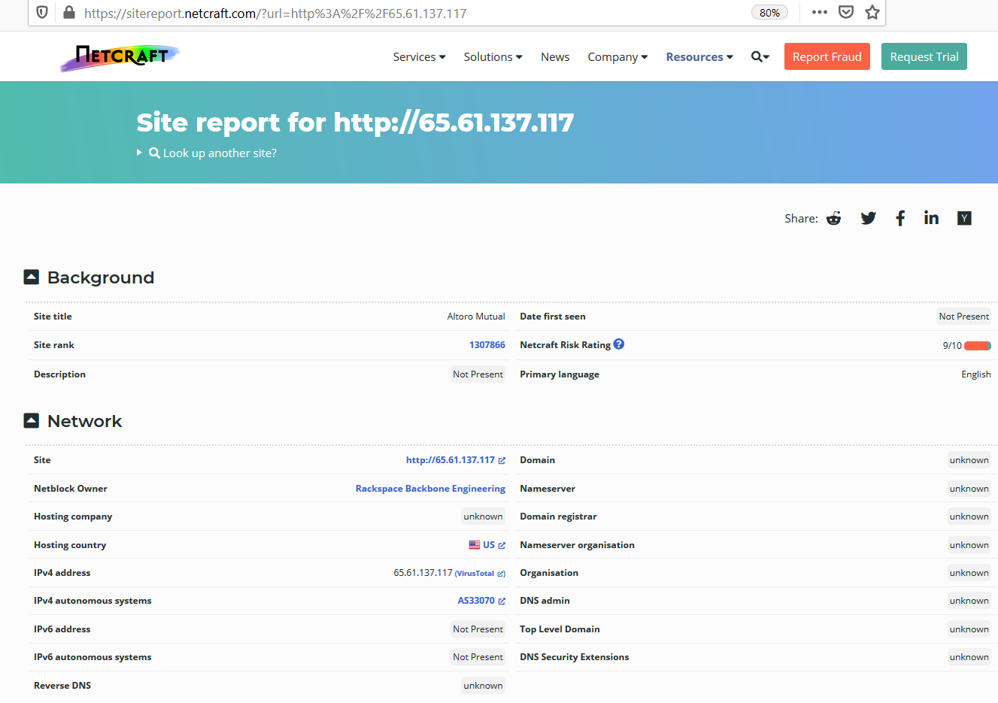
Mapping of Application Server Using Netcraft

Slide 13
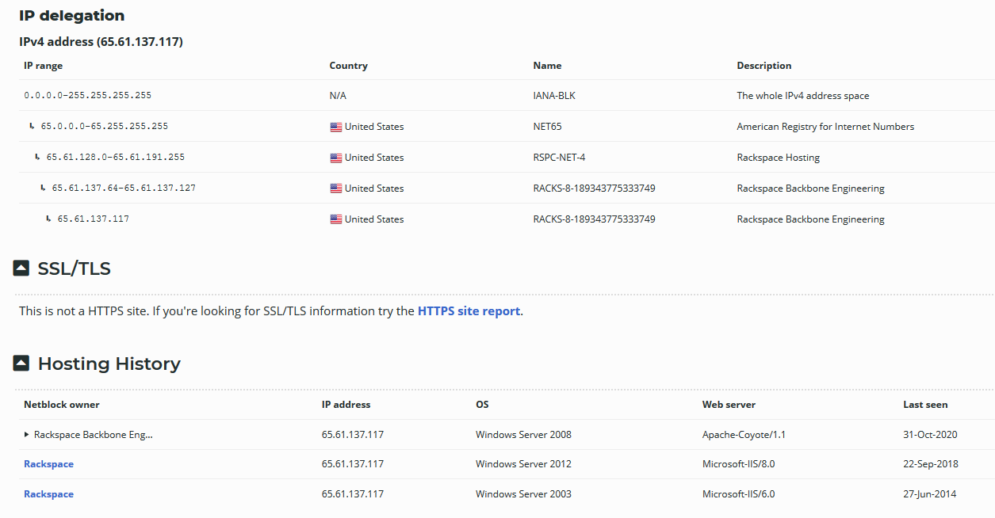
Mapping of Application Server Using Netcraft

Slide 14
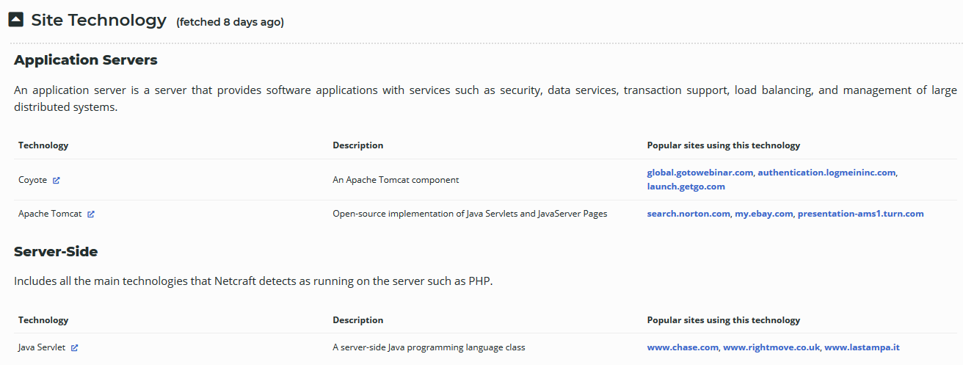
Mapping of Application Server Using Netcraft

Slide 15
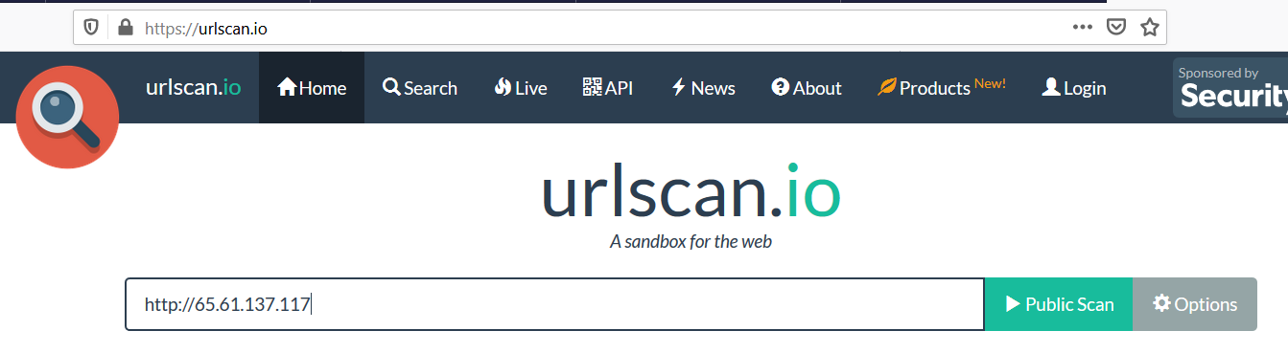
“urlscan.io” – scan server for infrastructure information and more
Try with: www.np.edu.sg
15

Slide 16
Examples of Popular Database Servers
MS SQL Server
MS SQL Server is a relational database management system built for the basic function of storing retrieving data as required by other applications.
MySQL
Enterprises can commence out utilizing the free community server and later upgrade to the commercial version.
Oracle RDBMS
Oracle database is the most widely used object-relational database management software.
SAP Sybase ASE
ASE stands for Adaptive Server Enterprise. Its latest version is 15.7. It was started in the middle of the eighties.
IBM DB2
DB2 is a database product from IBM. DB2 is designed to store, analyze and retrieve the data efficiently.
PostgreSQL
PostgreSQL is a particularly scalable object-relational database. Developed based on POSTGRES 4.2 at Berkeley Computer Science Department, University of California.
16

Slide 17
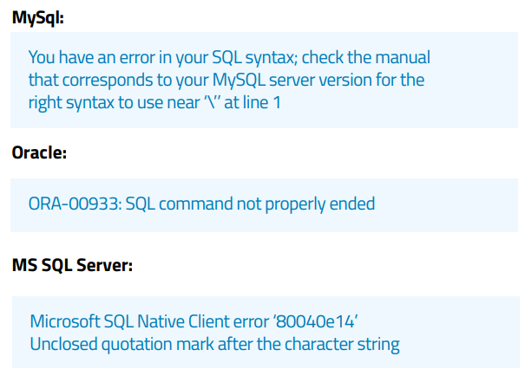
Mapping of Database Server
One way to find out what database the web application system is using is to read the return error message
Other ways will be covered under SQL Injection section

Slide 18
HTTP Methods

Slide 19
HTTP Methods
The browser makes use of the following REQUEST methods to get the server to act.
Some of the common methods are as follows:
OPTIONS
GET
PUT
POST
DELETE
HEAD
TRACE
CONNECT
10/19/2022
1020-WAPT-Session 2.1-Reconnaissance Basic
19

Slide 20
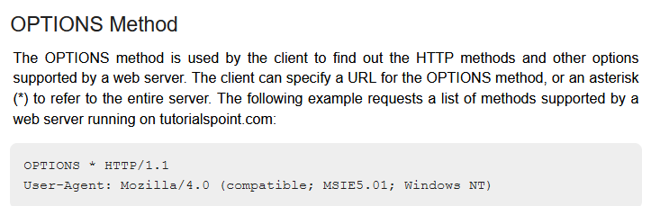

Slide 21
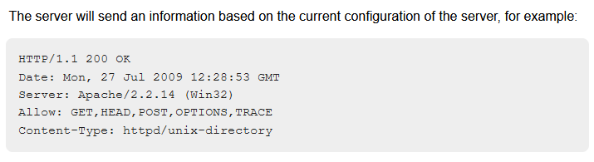

Slide 22
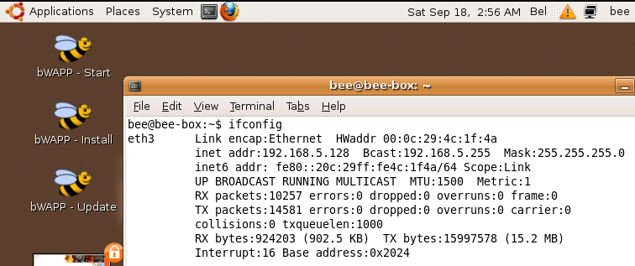
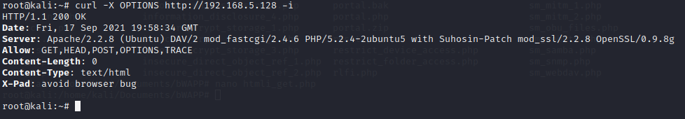
Activity 1.2 - To check for Methods supported by the Web Server
No submission needed.
Using curl command executed in Kali Linux 2020.3 VM, network setting is HOST only. This copy of Bee-Bug 2.2 downloaded from Internet and is original without modification.

Slide 23
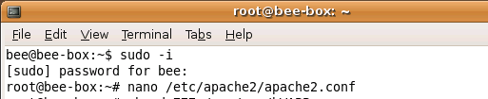
Modification to “apache2.conf” file
UPDATED
Cut and paste these code and place at the bottom of the apache2.conf file.
<Directory "/">
Dav On
<LimitExcept GET HEAD OPTIONS PUT>
Allow from all
</LimitExcept>
</Directory>

Slide 24
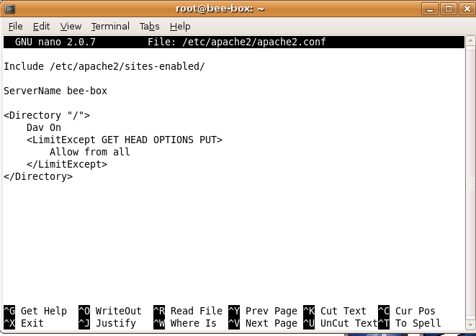

Modification to “apache2.conf” file
UPDATED
Press <ctrl><x> to save file and exit.
Reboot the OS and continue/You can also restart the httpd service as follows:.

Slide 25
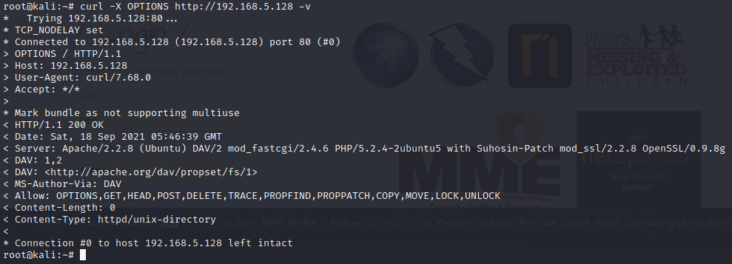
UPDATED
Test it in Kali Linux ….

Slide 26
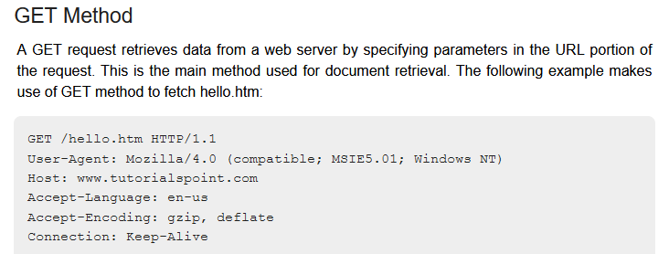

Slide 27
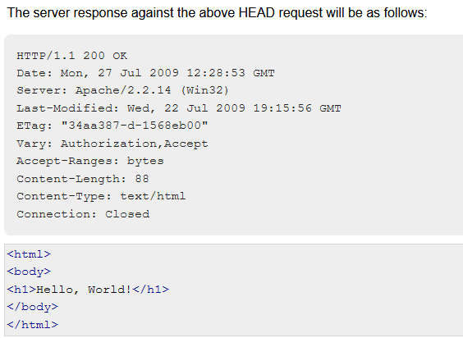
GET

Slide 28
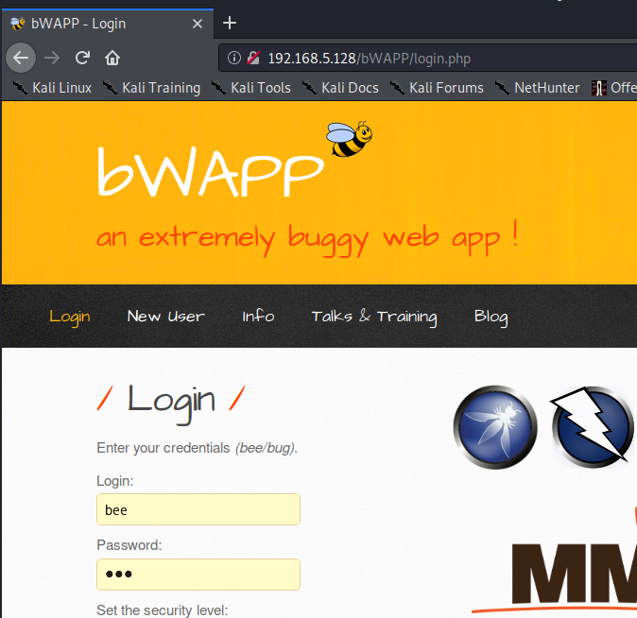
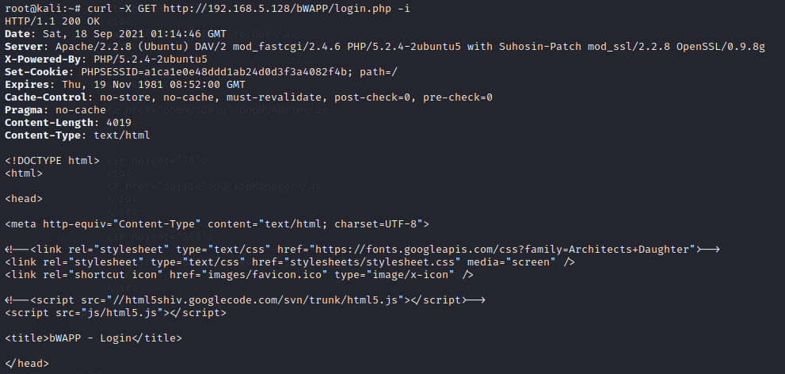
Activity 1.2 - To test GET method supported by the Server
Using curl command executed in Kali Linux 2020.3 VM, network setting is HOST only.

Slide 29
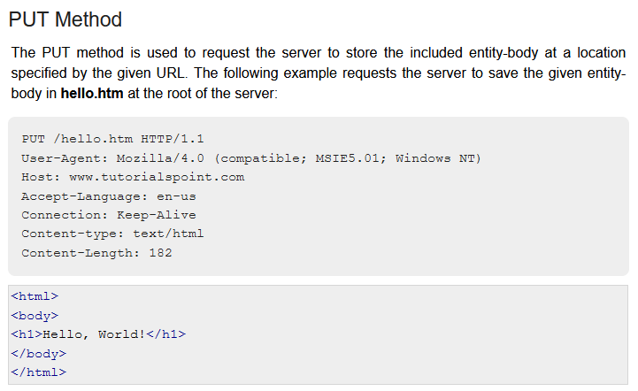
Use to Create resource
Notes:
29

Slide 30
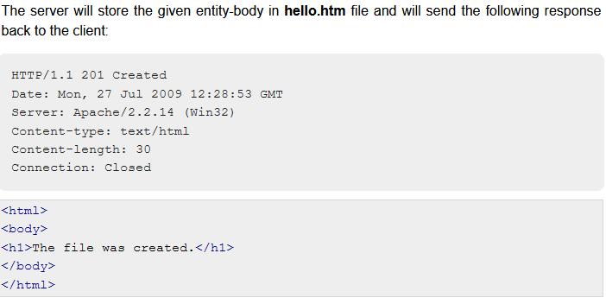

Slide 31
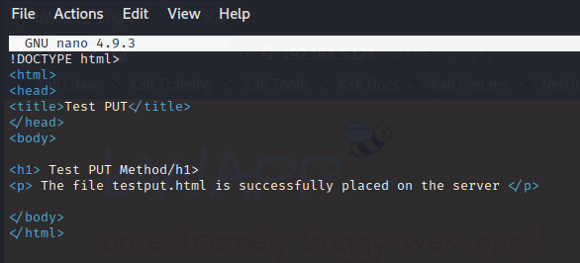
Activity 1.2 - To test PUT method supported by the Server
First create a html file in Kali Linux 2020.3 using a text editor…

Slide 32
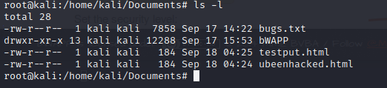
Save it somewhere …

Slide 33
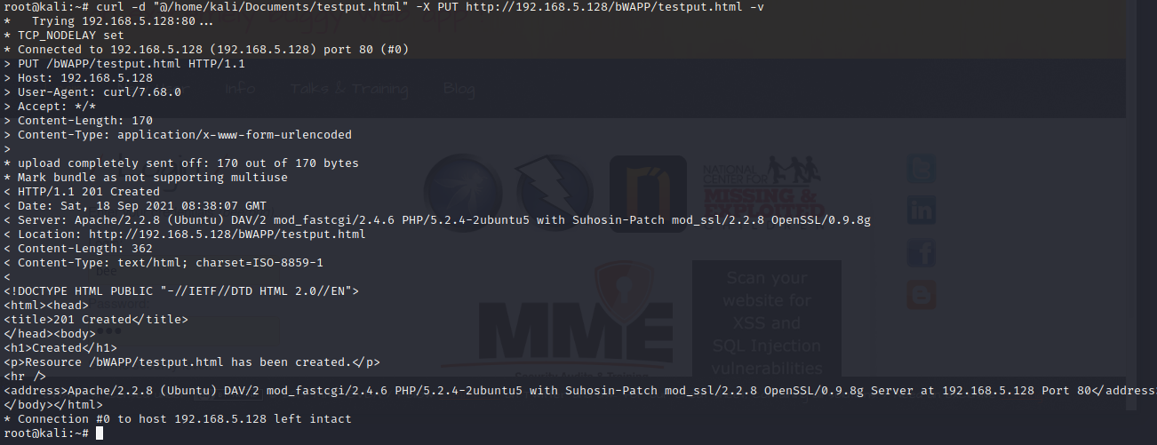
curl -d "@/home/kali/Documents/testput.html" -X PUT http://192.168.5.128/bWAPP/testput.html -v

Slide 34
Check the bee-box Linux , the file has indeed uploaded using the PUT method

Slide 35
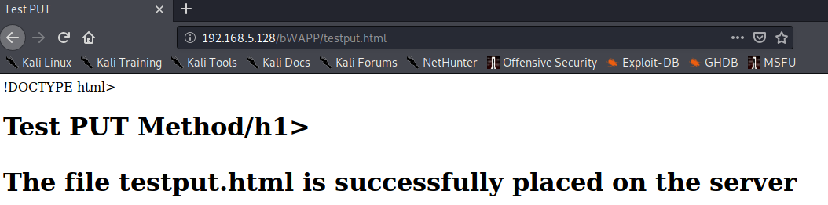
Load the file in the Kali Linux’s browser…

Slide 36
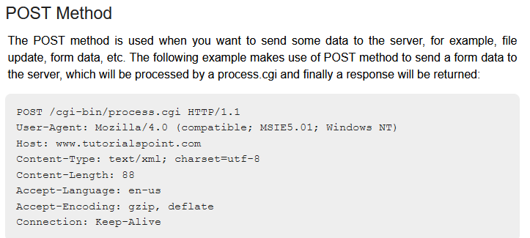
To Update/Modify

Slide 37
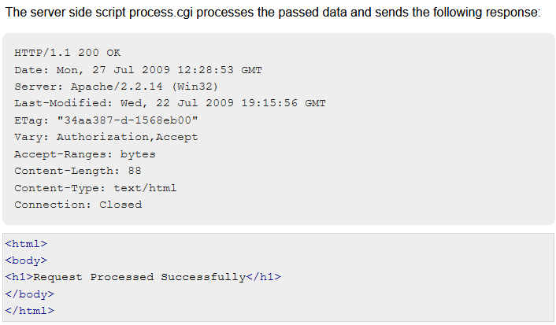

Slide 38
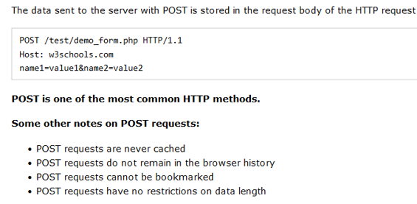

Slide 39
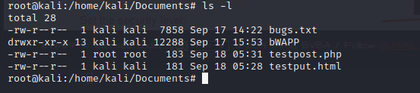
Activity 1.2 - To test POST method supported by the Server
Save it somewhere …

Slide 40
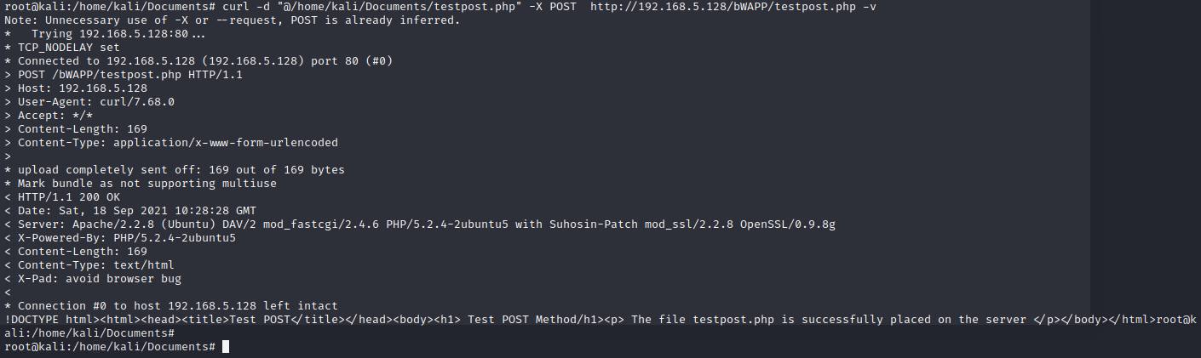
The file testpost.php must first be created using PUT method
curl -d "@/home/kali/Documents/testpost.php" -X POST http://192.168.5.128/bWAPP/testpost.php -v

Slide 41
Watch the video at the URL below to consolidate what you have learned thus far ….
https://www.youtube.com/watch?v=guYMSP7JVTA

Slide 42
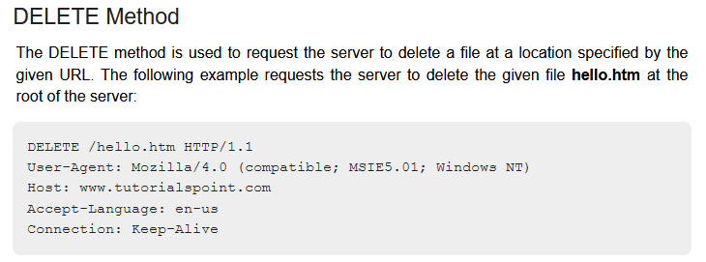

Slide 43
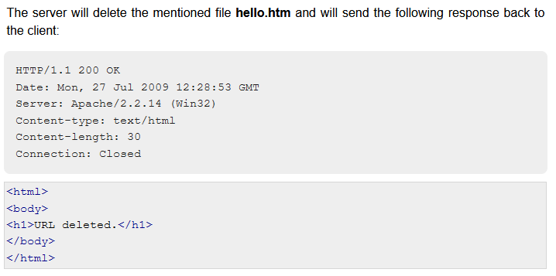

Slide 44
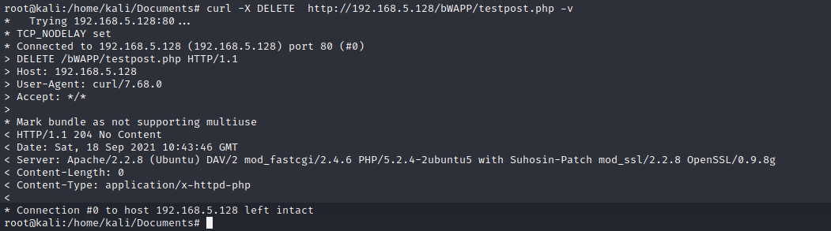
Activity 1.2 - To test DELETE method supported by the Server
curl -X DELETE http://192.168.5.128/bWAPP/testpost.php -v

Slide 45
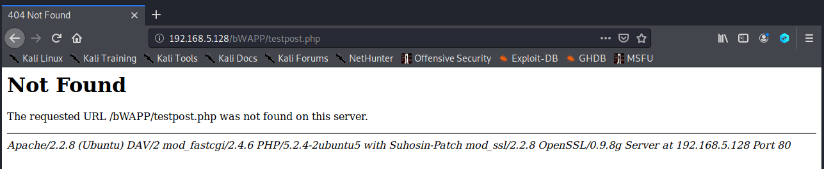

Slide 46
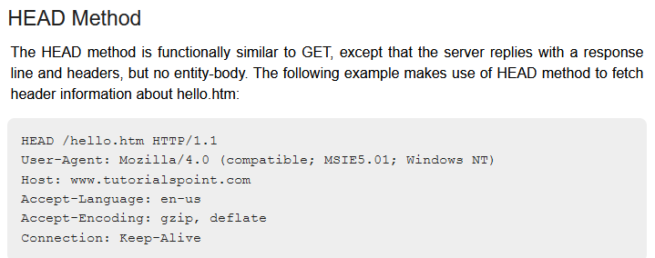

Slide 47
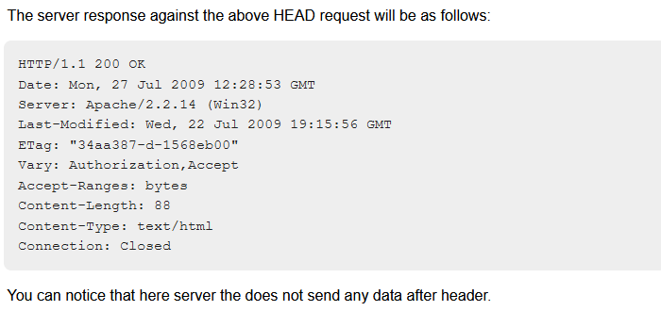

Slide 48
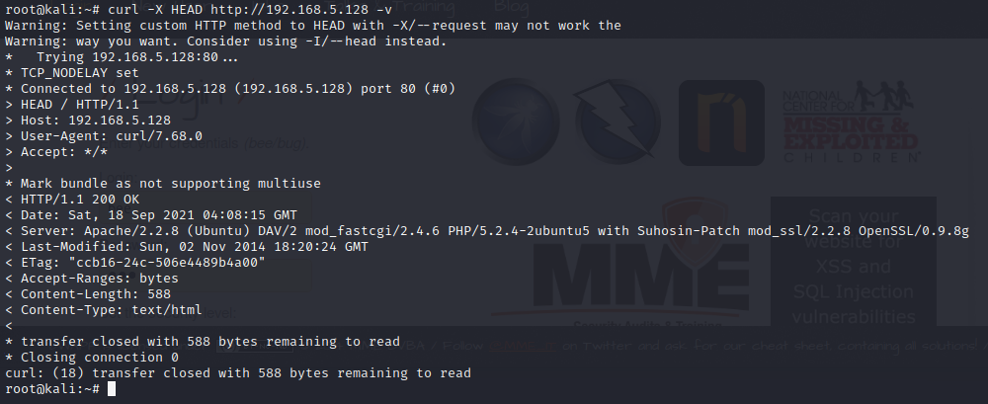
Activity 1.2 – To test HEAD Method to retrieve Headers …
No submission needed.

Slide 49
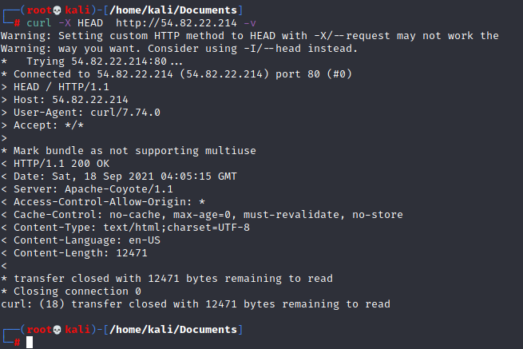

Slide 50
TRACE: will echo the request as seen by the server back to the client for diagnostic purposes
Allows the hacker to see any changes made by intermediate servers such as proxy
Changes to the request may be made by the inbound or outbound proxies

Slide 51
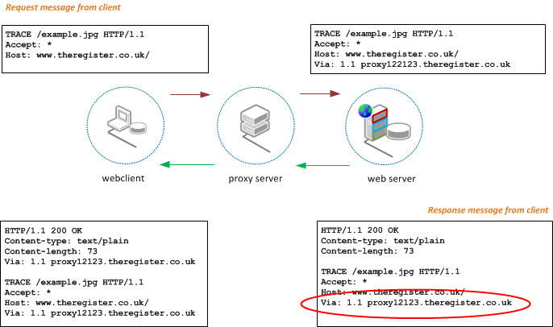

Slide 52
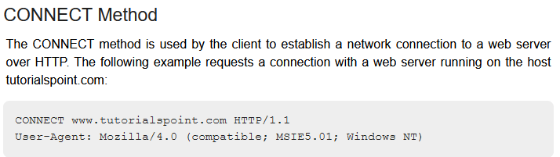

Slide 53
